Slide 1
Classification of Active Learning Enabled Activity Recognition
Chen Shang, Chris Sanders, Thomas Silbernagel, & Michael Towns
Notes:
Chen

Slide 2
Problem Statement & Objective
Problem Statement
We are attempting to accurately identify the physical activities that humans are doing and increase efficiency of data collection.
Objective
Body-in-motion data is relevant to health and building management
Large variance in human movement requires broad definitions for each activity
Fewer attributes means potentially less data to collect and store
Notes:
Michael
,

Slide 3

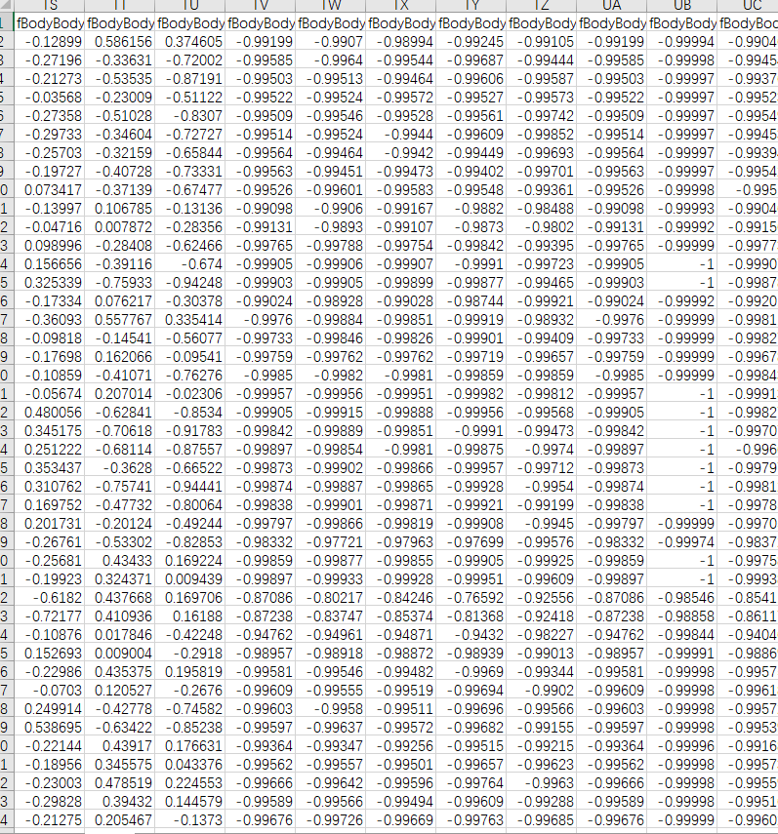
Data Source
10299 records generated from 30 individuals wearing a smartphone on the waist
561 attributes generated from things like angular velocity and acceleration
Classified into 6 labels:
WALKING
WALKING_UPSTAIRS
WALKING_DOWNSTAIRS
SITTING
STANDING
LAYING
Notes:
Chris
Human Activity Recognition Using Smartphones Data Set

Slide 4
Specific Aims
Data Preprocessing
Normalization
Feature Selection: Principal Component Analysis (PCA)
Data Selection
Data split: 70% training / 30% testing
Data Mining
Classification
Multi-Level Perceptron
Data Presentation
Plot accuracy
Confusion matrix
Notes:
Thomas

Slide 5
Success Criteria & Validation
Success Criteria
Correctly label 90% of the testing data
Validation
Able to successfully label the test data and verify it against the labels given for that data
Plot accuracy across multiple iterations of testing
Generate a confusion matrix based on tested data
Notes:
Chen

Slide 6
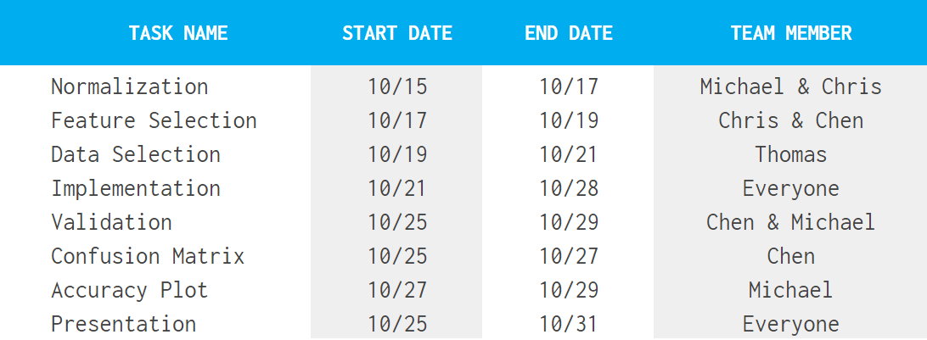
Timeline
Notes:
Michael

Slide 7
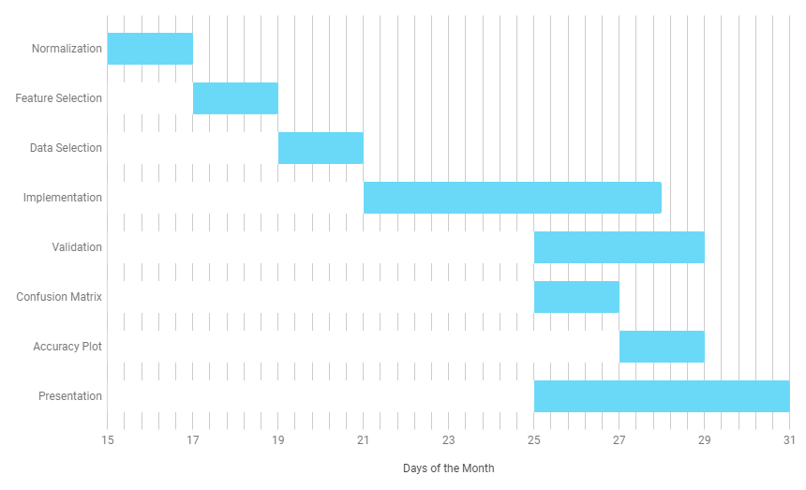
Gantt Chart
Notes:
Thomas

Slide 8
Classification of Active Learning Enabled Activity Recognition
Chen Shang, Chris Sanders, Thomas Silbernagel, & Michael Towns
Notes:
Chris

